Slide 1
WebGL based product marketing
Development
>>

Slide 2
Our team
Sreeram
Hema Shri
Ankita
BTech – 3rd year 211801390014@cutmap.ac.in
BTech – 4th year 201801330033@cutmap.ac.in
Diploma – 3rd year 211207140023@cutm.ac.in
<<
>>

Slide 3
01
Introduction
……
<<
>>

Slide 4
Introduction
WebGL-based product marketing development using 3D models is an innovative approach that leverages the power of the web and 3D graphics to showcase and promote products in an immersive and engaging manner. WebGL, which stands for Web Graphics Library, is a JavaScript API that enables high-performance rendering of 3D graphics in web browsers without the need for additional plugins.
In this context, product marketing development refers to the process of creating interactive and visually appealing experiences that effectively highlight the features and benefits of a product. By using 3D models, businesses can present their products in a more realistic and interactive way, allowing potential customers to explore and interact with them virtually.
<<
>>

Slide 5
02
Goal
……
<<
>>

Slide 6
Goals
Design
Develop
Deploy
Created 3D models
1
2
3
Integration in Unity 3D
Converting into WebGL
<<
>>

Slide 7
03
Strategy
……
<<
>>

Slide 8
Strategy
Product 1
Designing and texturing
Integration in Unity 3D
with UI
<<
>>

Slide 9
04
Initiative
……
<<
>>

Slide 10
INITIATIVE
To create realistic and high-quality 3D models to be marketed.
Integrate 3D models into a WebGL framework .
Design and implement interactive features to engage users, such as product customization.
Evaluate the effectiveness of the marketing experience in terms of user engagement, brand perception, and potential sales impact.
<<
>>

Slide 11
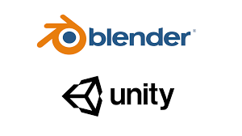
Technologies used
<<
>>

Slide 12
05
Our products
……
<<
>>

Slide 13
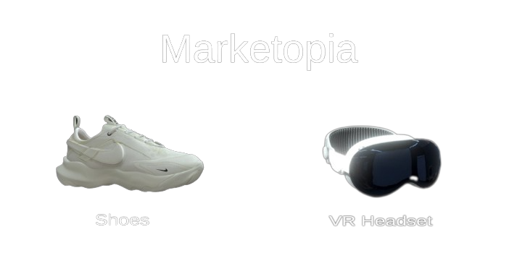
A WebGL based UI
<<
>>

Slide 14
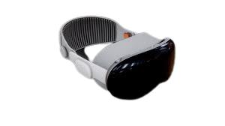
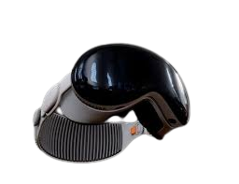
VR HEADSET
Product 1
<<
>>

Slide 15
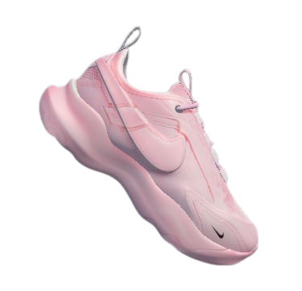
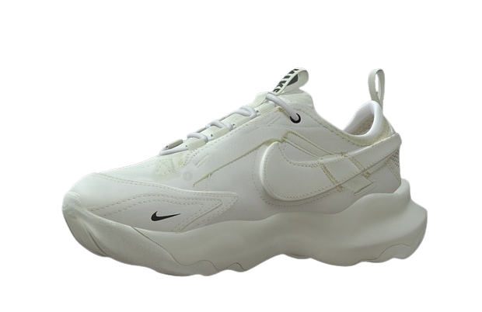
Product 2
<<
>>

Slide 16
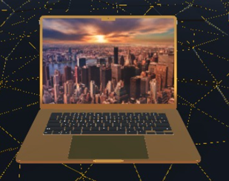
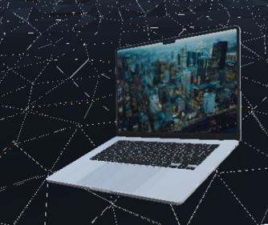
Mac book pro
Product 3
<<
>>

Slide 17
06
Final Deliverable
……
<<
>>

Slide 18
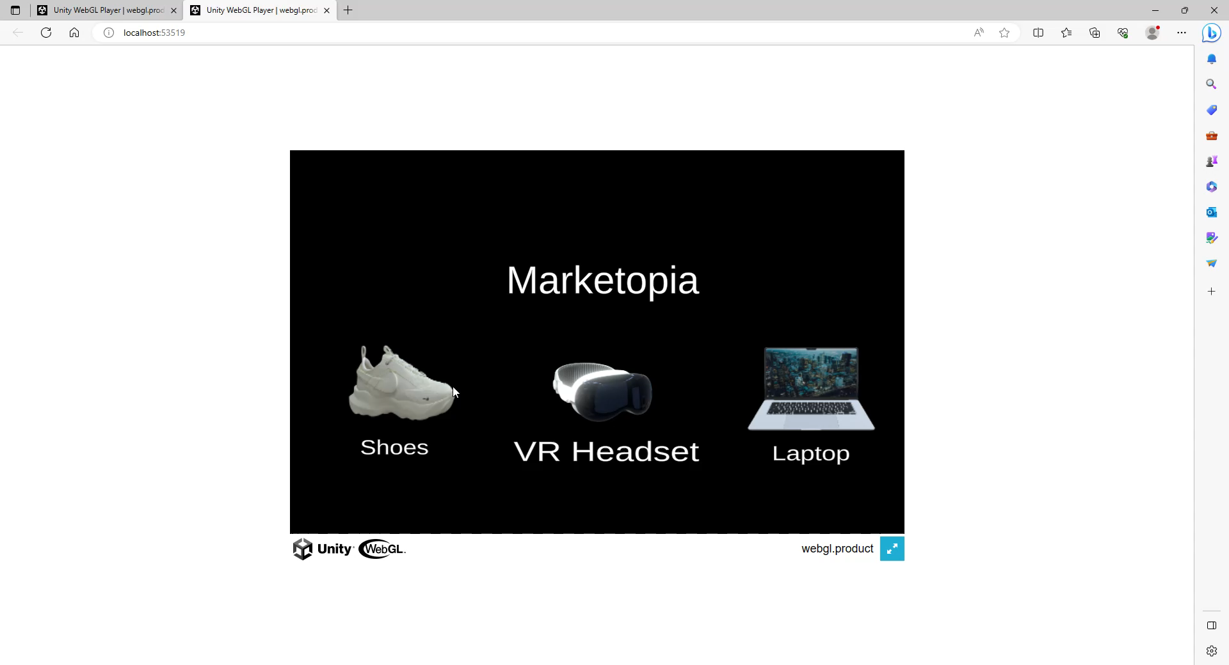
……
<<
>>

Slide 19

Thanks!
<<
>>

